Slide 1

AIRLINE RESERVATION SYSTEM
SUBMITTED BY:
PARINA
CO17343
A Project Report submitted in partial fulfilment of
the requirement for the award of
Bachelor of Engineering
IN
COMPUTER SCIENCE AND ENGINEERING

Slide 2
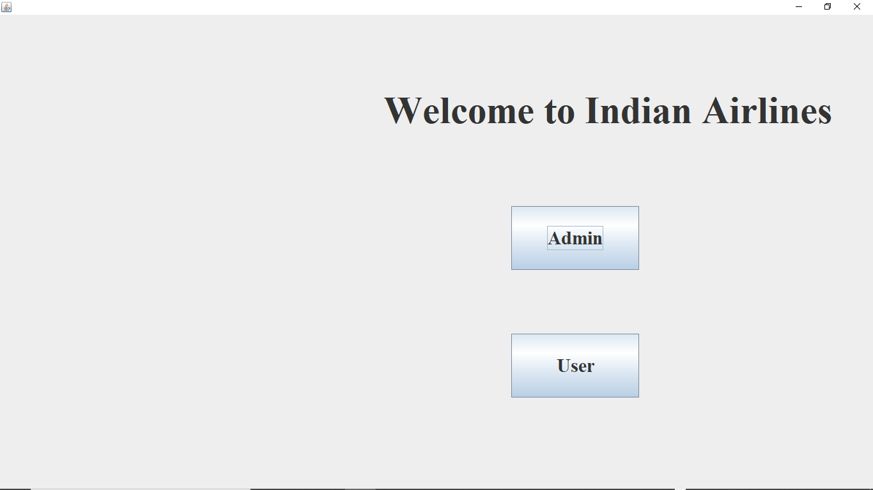
SCREENSHOTS OF MY PROJECT

Slide 3
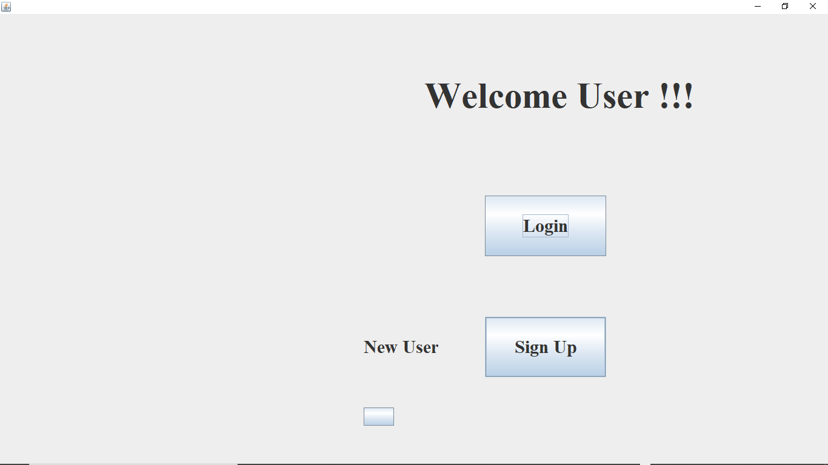

Slide 4
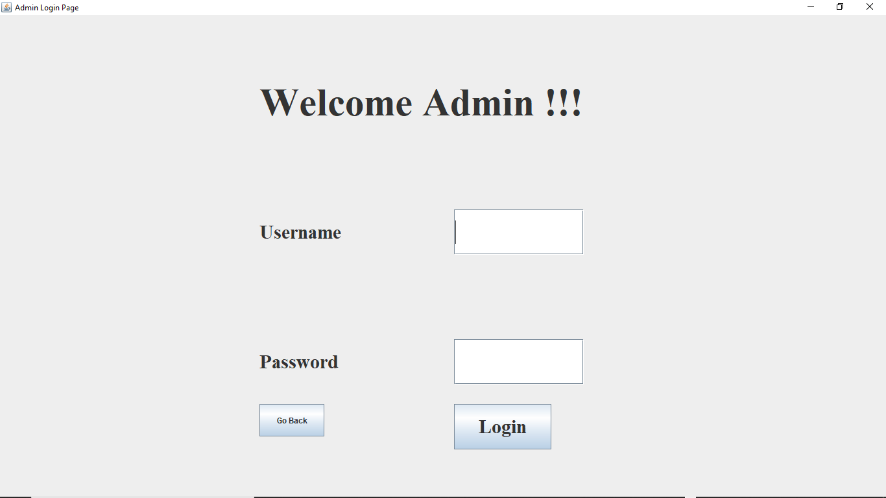

Slide 5
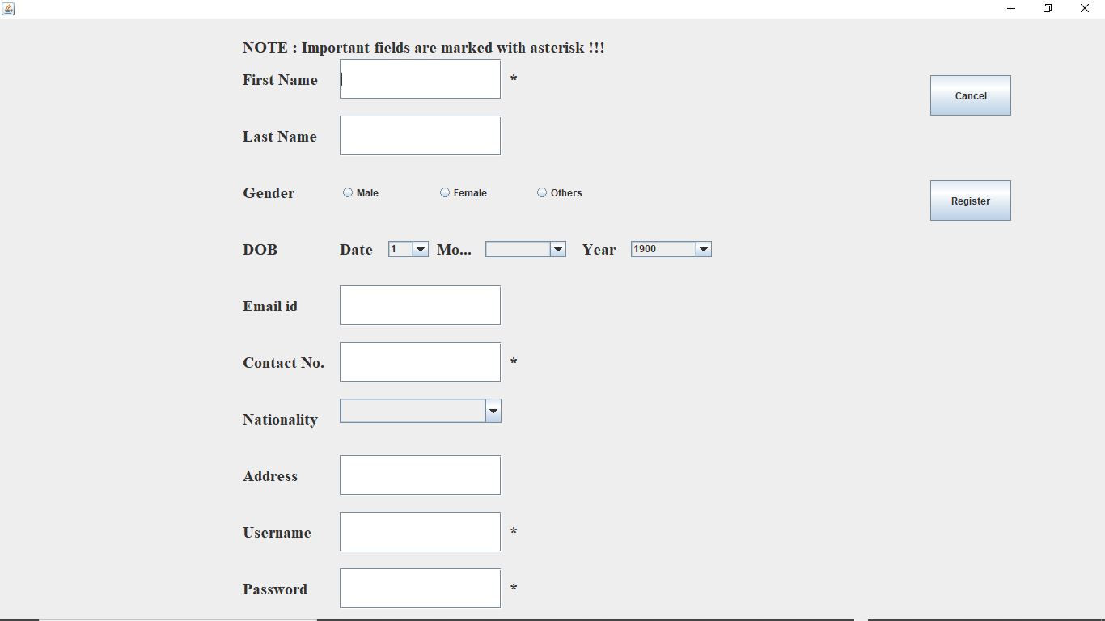

Slide 6
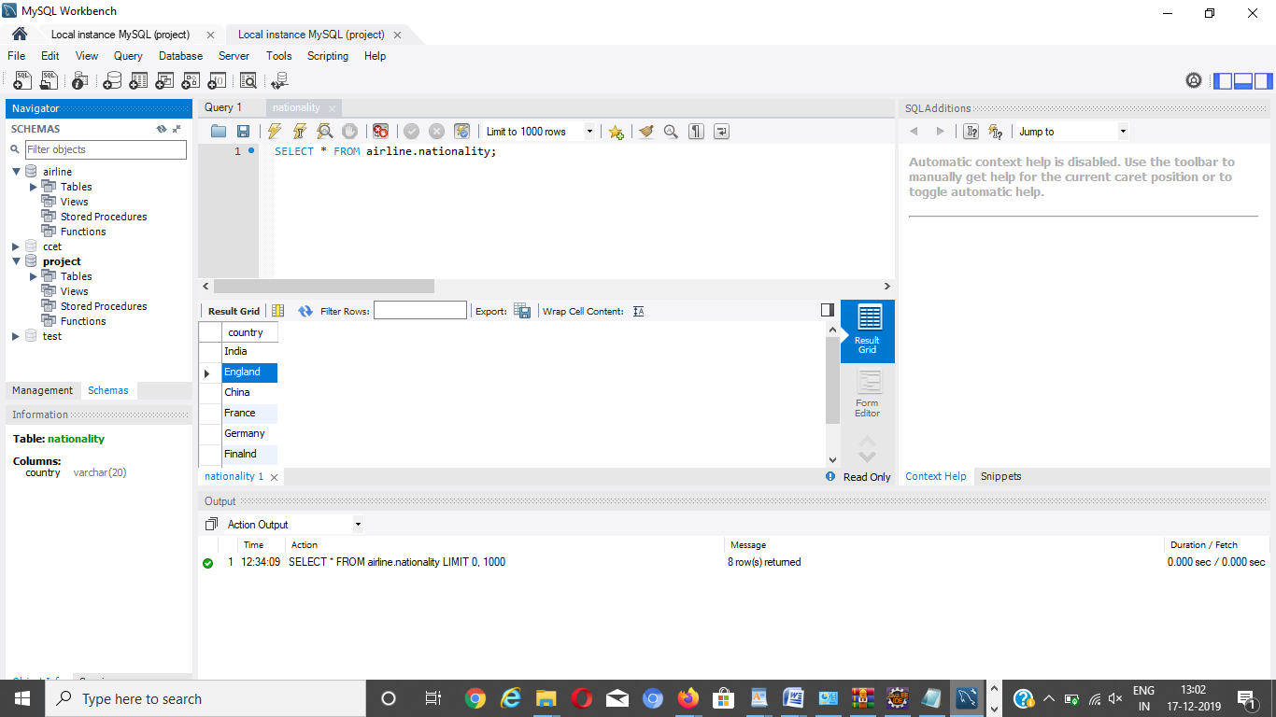

Slide 7
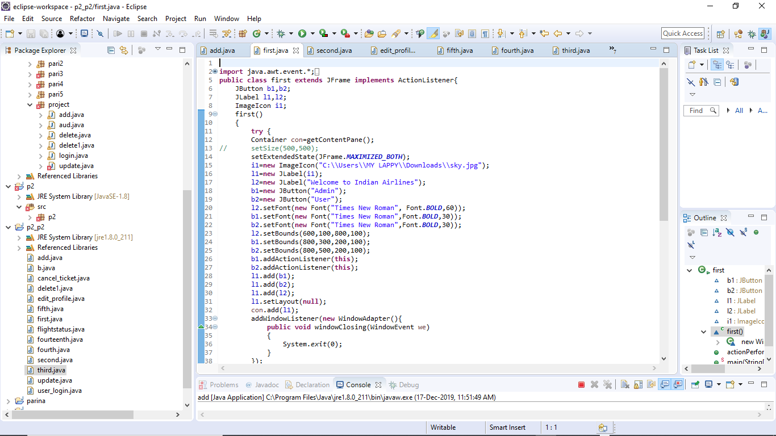

Slide 8
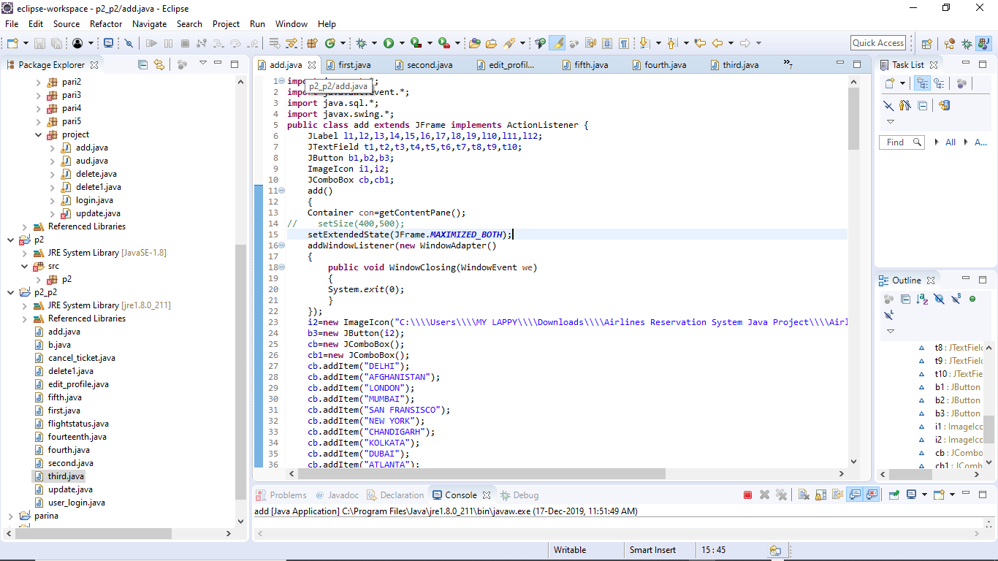

Slide 9
AIRLINE RESERVATION SYSTEM
Airline reservation system is an integrated passenger processing system. This system includes:
Fares
Inventory
Enquiry
Reservations
THIS PROJECT IS CONSTRUCTED BY USING ELLIPSE AND WORKBENCH MYSQL.

Slide 10
SOFTWARES USED
ECCLIPSE
(@ www.eclipse.org) is an open-source Integrated Development Environment (IDE) supported by IBM. Eclipse is popular for Java application development (Java SE and Java EE) and Android apps. It also supports C/C++, PHP, Python, Perl, and other web project developments via extensible plug-ins.
MYSQL WORKBENCH
MySQL Workbench is a visual database design tool that integrates SQL development, administration, database design, creation and maintenance into a single integrated development environment for the MySQL database system

Slide 11
LANGUAGE USED
JAVA
Java is a popular programming language, created in 1995.
It is owned by Oracle, and more than 3 billion devices run Java.
It is used for:
Mobile applications (specially Android apps)
Desktop applications
Web applications
Web servers and application servers
Games
Database connection
And much, much more!

Slide 12
INFORMATION ABOUT MYSQL
MySQL Workbench is a unified visual tool for database architects, developers, and DBAs. MySQL Workbench provides data modeling, SQL development, and comprehensive administration tools for server configuration, user administration, backup, and much more. MySQL Workbench is available on Windows, Linux and Mac OS X.

